Slide 1
Introduction to being a Change Agent

Slide 2
Learning outcomes
Verbalise your readiness for being a change agent
Create a draft tool to help with your change idea
Complete a draft Current State Assessment

Slide 3
Am I a change agent? YES you Are!
YOU Recognise deficiencies in practice ALL THE TIME
You AIM to fix them
You are in the BEST POSITION to do that with your colleagues
You can evoke widespread changes IF you have the practice, education and leadership infrastructure
Cusson, Meeham, Bourgault and Kelley (2020) Educating the next generation of nurses to be innovators and change agents. Journal of professional nursing 36.13-19)
Bondurant & Armstrong. (2016). Nurses: Leading Change and Transforming Care – Expert Opinion. 16. 155-160.

Slide 4
Success factors
Have a dedicated change agent
Have clarity about the purpose and anticipated results of the change
Have motivation and ongoing support of staff throughout the change process
Clearly assigned and accepted responsibility for implementing the change
An environment that encourages change
Leading Change in Practice (2004). The Manager, 13(3). Supported by the WHO

Slide 5
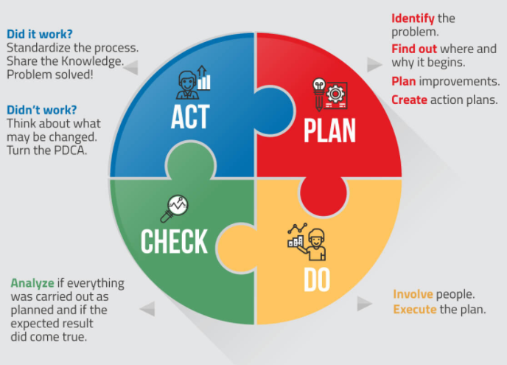
5 phases in leading change
Recognising the challenge – gap between desired and actual achievement
Identifying a promising practice - high level of success and transferability
Adapt and test one promising practice
Implement
Scale up the successful practice/
underpinning system
Leading Change in Practice (2004). The Manager, 13(3). Supported by the WHO
www.siteware.co/en/methodologies/how-to-do-pdca-step-by-step/

Slide 6
Assessment of readiness

Slide 7
Take 5 Power Point Presentation tool
Helps to establish succinctly
What practice you want to change, is an issue
The reason/need for the change – what’s going on?
Whats in it for me? – to gather followers in your intiative
What will be the expectations of the improvement initiative

Slide 8
Medication Safety Current Assessment
As well as establishing if your area is ready for any change its helpful to understand where your culture of medication safety sits against standards
The current state assessment allows you to self assess your areas culture against medication safety standards
A current state assessment tool is on the CDHB Link page and IV link forum in healthLearn

Slide 9
Did you achieve your Learning outcomes?
Verbalise your readiness for being a change agent
Create a draft tool to help with your change idea
Complete a current state assessment

